Slide 1
BCIS 5110.007
PROGRAMMING LANGUAGE FOR BUSINESS ANALYTICS
MISSING MIGRANTS

Slide 2
INTRODUCTION
Migration is a major worldwide issue with severe humanitarian issues. Migration also has major effects on origin country like brain drain and loss of young people. Migrants are majorly affected by discrimination, cultural clash and segregation. Main motivation behind picking this dataset for our project was the curiosity when we spotted lots of Migrants from different origin particularly around us in odd jobs and other places. With this curiosity when we did a bit of research online, we found out North America is the highest used route for migration. This paper provides a thorough examination of a dataset that we used which includes 13,370 items pertaining to migration occurrences.

Slide 3
DATA DESCRIPTION AND ATTRIBUTES
Our dataset represents information collected by the Missing Migrants Project, tracking incidents involving migrants, refugees, and asylum-seekers who have died or gone missing during their migration journey to an international destination. This dataset contains 13370 rows and 25 columns. The dataset contains missing values in various columns, such as "Website Date," "Number of Dead," "Minimum Estimated Number of Missing," etc.
Below mentioned are our attributes for the dataset
Main ID, Incident ID, Incident Type, Region of incident, website date, Incident year, Reported month, Number of dead, Minimum Estimated Number of Missing, Total Number of dead and missing, Number of survivors, Number of females, Number of males, Number of Children, Region of origin, Cause of death, Country of origin, Migration Route, Location of death, Information Source, Coordinates, UNSD Geographical Grouping.

Slide 4
Data Transformation/Exploratory Data Analysis:
Cleaning data is the primary step in data analysis to make sure that the data is accurate, consistent, and ready for further analysis. Common cleaning tasks are removing duplicates, transforming data types, and dealing with outliers.
Transforming data means identifying and handling missing data using techniques like imputation or removal of missing values
We explored our data using describe function which helped us to understand data distribution across all columns. And also using info function from pandas helped us to understand datatypes and missing values
In our project we imputed missing values in numeric columns with zeroes according to description provided from source. For a few columns we imputed missing values with median method because those columns represent number of individuals. Also, columns containing unnecessary information were dropped from dataset. Few rows where we cannot impute values in either way were dropped for accuracy in analysis.

Slide 5
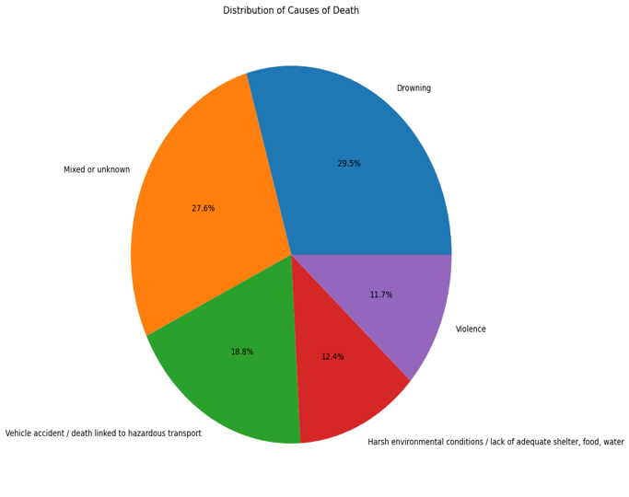
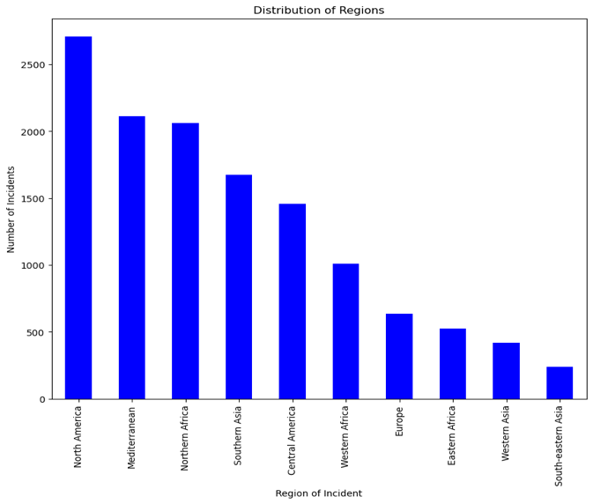
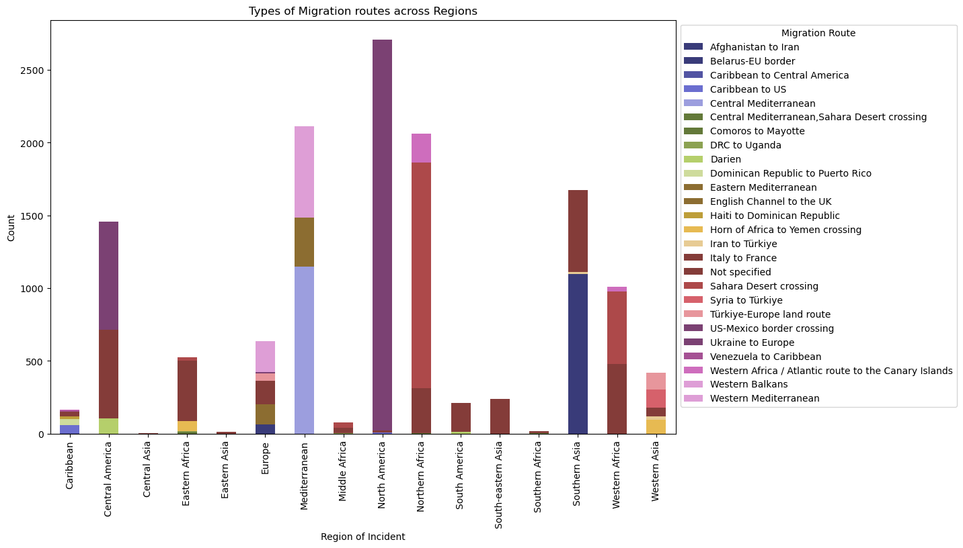
ANALYSIS
We started our analysis by understanding the distributions of cause of death, regions where a greater number of migrations occurred, and migration route used by migrants across different regions.

Slide 6
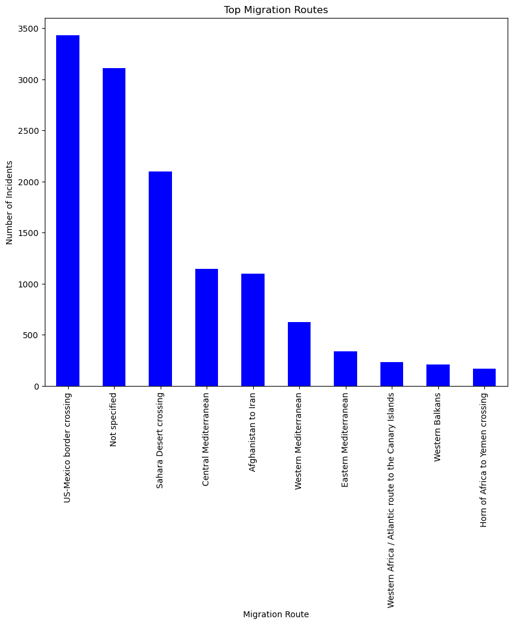
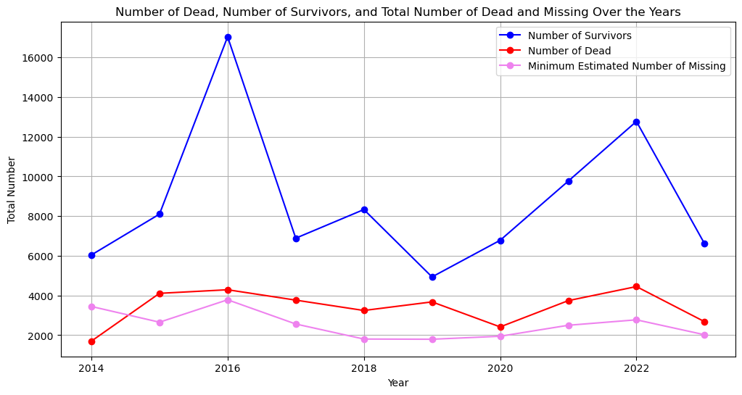
With the below line chart, we want to depict the Comparison between number of dead people, Number of survivors and number of missing people over the years during the events.
Among these migration routes US- Mexico border crossing has more migrations than any other route.

Slide 7
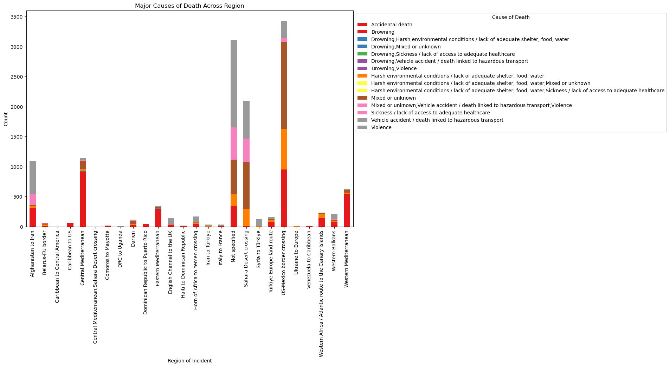
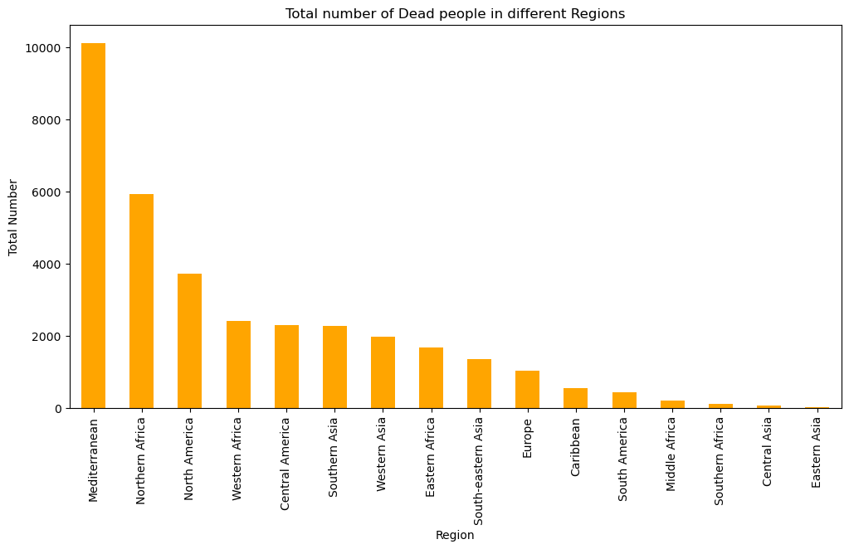
Here the focus is on which region has greater number of deaths and what are the causes for death. this analysis will mainly help us to keep the UN informed of the steps that are needed to be taken.
Regions where more number of deaths occurred.

Slide 8
Findings:
Leading Causes of Death: Drowning
Routes and regions of high migration: US-Mexico border and North America region has more migrations
Comparsion of Dead and survivors: There is a survival rate of 59 %
Analysis of Regional Deaths: Mediterranean region has more number of deaths
Managerial Implications:
Safety precautions and training
Reform immigration policies to create safe migrations.
Monitoring and response systems in real time
Urgency of UN Intervention in Mediterranean region
Increase Security and Awareness

Slide 9
Conclusions
This paper thoroughly examines migration across regions using extensive data cleaning and analysis, revealing critical trends and insights. The addition of the "Survival Rate" indicator expands our understanding beyond typical quantitative measures. This statistic provides unique insights into the human factors and implications of migration by comparing survivors to total migrants. The findings, enhanced by this new metric, give a solid foundation for informed decision-making, policy formulation, and international collaboration to solve the complexities of migration concerns. The study emphasizes the continual significance of improving analytical tools to gain a better knowledge of migration patterns.

Slide 10
Thank You

